Slide 1
Manual App Registration & Authentication

Slide 2
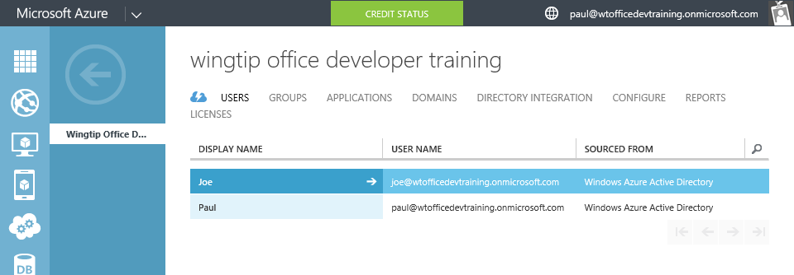
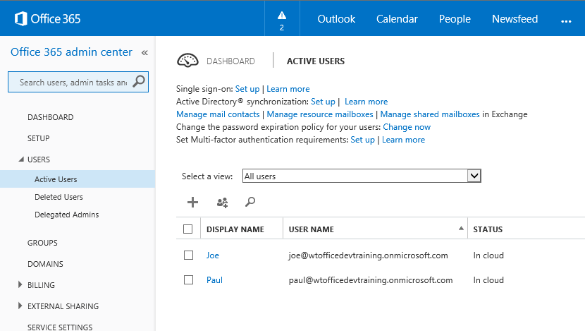
Azure Active Directory (Azure AD)
Included in Office 365 Subscription
Users & Groups managed in Office 365 Portal
Changes persisted in Azure AD
Notes:
Although an Azure AD is included with Office 365, accessing it via the Azure Management Portal requires a “sign-up.” However, there are no charges from Azure for using AD. (Charges will occur if other services are used.)

Slide 3
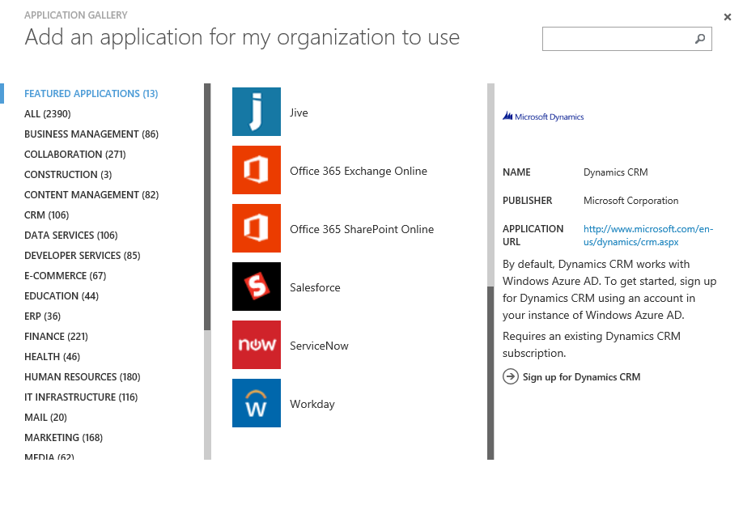
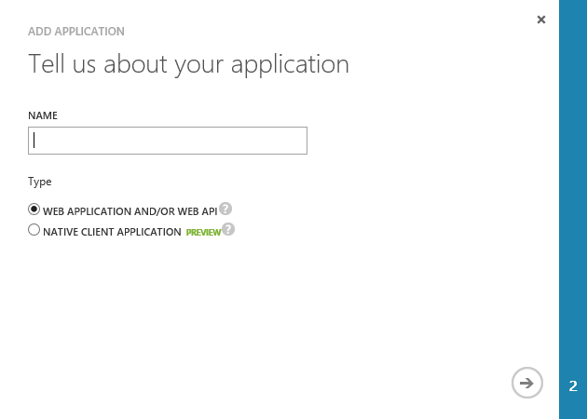
Application Registration
Application Types
Custom developed
Third-party, published in the gallery
Office 365 SharePoint, Exchange
Dynamics CRM
Thousands of others
Custom Applications
Web Application and/or WebAPI
Native Client

Slide 4
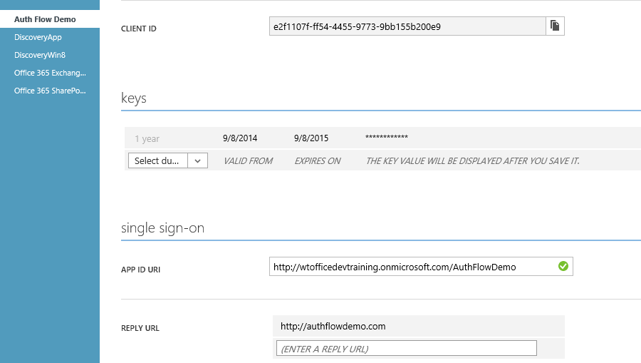
Custom Application Registration
Key information
Client ID
Keys (aka Client Secret)
Redirect /Sign-On URI

Slide 5
DEMO
Connecting MVC to Office 365

